Slide 1
haDerek - a Guide to the ‘Hebrew’ Way
MORE Arguments Against the Way
amiyisrael.org

Slide 2
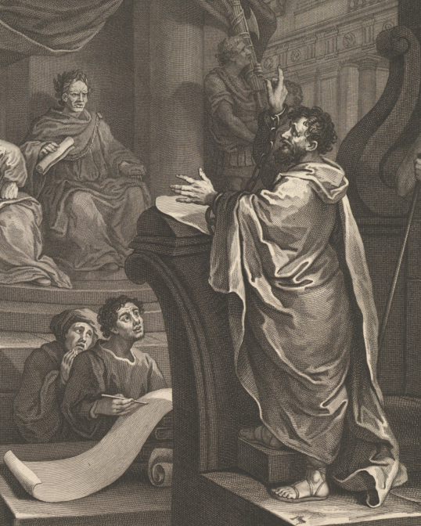
Acts 24:14-15 ¹⁴ "But this I confess to you, that according to the Way which they call a sect, so I worship the God of my fathers, believing all things which are written in the Law and in the Prophets. ¹⁵ "I have hope in God, which they themselves also accept, that there will be a resurrection of the dead, both of the just and the unjust.
2
amiyisrael.org

Slide 3
Isaiah 58:13-14 ¹³ " If you turn away your foot from the Sabbath, From doing your pleasure on My holy day, And call the Sabbath a delight, The holy day of the LORD honorable, And shall honor Him, not doing your own ways, Nor finding your own pleasure, Nor speaking your own words, ¹⁴ Then you shall delight yourself in the LORD; And I will cause you to ride on the high hills of the earth, And feed you with the heritage of Jacob your father.
3
amiyisrael.org

Slide 4
^{NKJ} Micah 2:1 Woe to those who devise iniquity, And work out evil on their beds! At morning light they practice it, Because it is in the power of their hand. ² They covet fields and take them by violence, Also houses, and seize them. So they oppress a man and his house, A man and his inheritance. ³ Therefore thus says the LORD: "Behold, against this family I am devising disaster,
4
amiyisrael.org

Slide 5
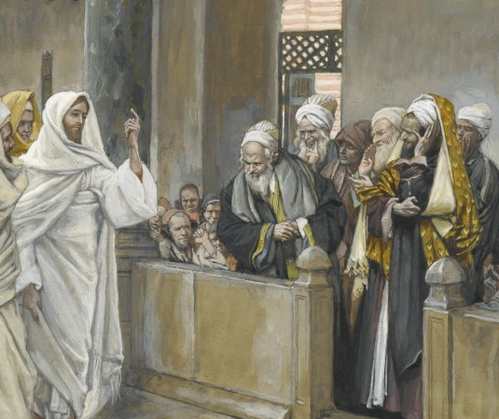
Matthew 22:29 " . . .You are mistaken, not knowing the Scriptures nor the power of God.
5
amiyisrael.org

Slide 6
Matthew 22:29 " . . .You are mistaken, not knowing the Scriptures nor the power of God.
“planao” (St. 4105)
“to cause to stray, lead aside from the right way”
6
amiyisrael.org

Slide 7
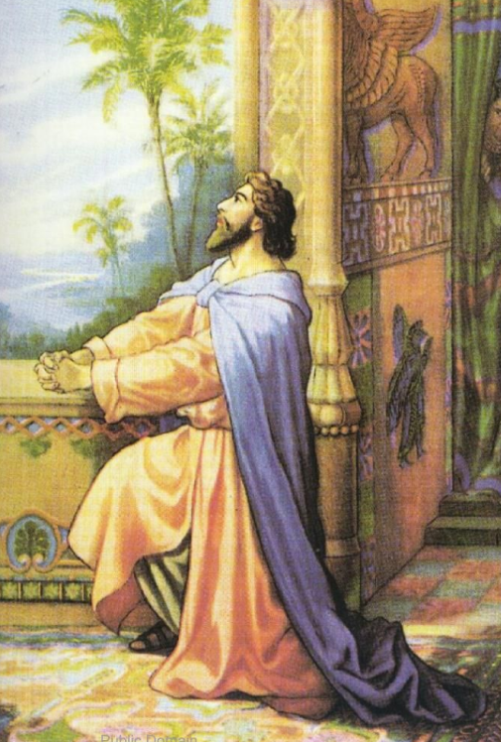
^{NKJ} Daniel 9:11 "Yes, all Israel has transgressed Your law, and has departed so as not to obey Your voice; therefore the curse and the oath written in the Law of Moses the servant of God have been poured out on us, because we have sinned against Him.
7
amiyisrael.org

Slide 8
^{NKJ} Isaiah 44:21-22 " Remember these, O Jacob, And Israel, for you are My servant; I have formed you, you are My servant; O Israel, you will not be forgotten by Me! ²²I have blotted out, like a thick cloud, your transgressions, And like a cloud, your sins. Return to Me, for I have redeemed you."
^{NKJ} Isaiah 43:25 " I, even I, am He who blots out your transgressions for My own sake; And I will not remember your sins.
8
amiyisrael.org

Slide 9
^{NKJ} Isaiah 44:21-22 " Remember these, O Jacob, And Israel, for you are My servant; I have formed you, you are My servant; O Israel, you will not be forgotten by Me! ²²I have blotted out, like a thick cloud, your transgressions, And like a cloud, your sins. Return to Me, for I have redeemed you."
^{NKJ} Isaiah 43:25 " I, even I, am He who blots out your transgressions for My own sake; And I will not remember your sins.
^{NKJ} Psalm 85:2 You have forgiven the iniquity of Your people; You have covered all their sin.
9
amiyisrael.org

Slide 10
^{NKJ} Hosea 8:12 I have written for him the great things of My law, But they were considered a strange thing.
10
amiyisrael.org

Slide 11
Question #4-
“ . . . are we not under the “New Covenant”?
^{NKJ} Jeremiah 31:31-33 ³¹ " Behold, the days are coming, says the LORD, when I will make a new covenant with the house of Israel and with the house of Judah -- ³² "not according to the covenant that I made with their fathers in the day that I took them by the hand to lead them out of the land of Egypt, My covenant which they broke, though I was a husband to them, says the LORD. ³³ "But this is the covenant that I will make with the house of Israel after those days, says the LORD: I will put My law in their minds, and write it on their hearts; and I will be their God, and they shall be My people.
.
11
amiyisrael.org

Slide 12
Question #4-
“ . . . are we not under the “New Covenant”?
^{NKJ} Hebrews 8:1 Now this is the main point of the things we are saying: We have such a High Priest, who is seated at the right hand of the throne of the Majesty in the heavens . . .
12
amiyisrael.org

Slide 13
Question #4-
“ . . . are we not under the “New Covenant”?
^{NKJ} Hebrews 8:1 Now this is the main point of the things we are saying: We have such a High Priest, who is seated at the right hand of the throne of the Majesty in the heavens . . .
Note - italicized
^{NKJ} Hebrews 8:7-8 For if that first covenant had been faultless, then no place would have been sought for a second. ⁸ Because finding fault with them, He says: "Behold, the days are coming, says the LORD, when I will make a new covenant with the house of Israel and with the house of Judah --
the priesthood
13
amiyisrael.org

Slide 14
Question #4-
“ . . . are we not under the “New Covenant”?
^{NKJ} Malachi 2:1-2;7 "And now, O priests, this commandment is for you. ² If you will not hear, And if you will not take it to heart, To give glory to My name," Says the LORD of hosts, "I will send a curse upon you, And I will curse your blessings. Yes, I have cursed them already, Because you do not take it to heart . . . ⁷ "For the lips of a priest should keep knowledge, And people should seek the law (“torah” – Strong’s 8451) from his mouth; For he is the messenger of the LORD of hosts.
.
14
amiyisrael.org

Slide 15
Question #4-
“ . . . are we not under the “New Covenant”?
^{ESV} Hebrews 9:15 Therefore he (Yeshua) is the mediator of a new covenant, so that those who are called may receive the promised eternal inheritance, since a death has occurred that redeems them from the transgressions committed under the first covenant.
15
amiyisrael.org

Slide 16
Question #4-
“ . . . are we not under the “New Covenant”?
^{ESV} Hebrews 9:15 Therefore he (Yeshua) is the mediator of a new covenant, so that those who are called may receive the promised eternal inheritance, since a death has occurred that redeems them from the transgressions committed under the first covenant.
^{NKJ} Jeremiah 31:33 ³³ "But this is the covenant that I will make with the house of Israel after those days, says the LORD: I will put My law (“torah” – Strong’s 8451) in their minds, and write it on their hearts; and I will be their God, and they shall be My people.
16
amiyisrael.org

Slide 17
Question #4-
“ . . . are we not under the “New Covenant”?
The Torah will be written on the heart
^{NKJ} Proverbs 7:2-3 ² Keep my commands and live, And my law as the apple of your eye. ³ Bind them on your fingers; Write them on the tablet of your heart.
The firstborn will be the priests, and the “first” firstborn will be High Priest
^{NKJ} Numbers 3:11-12 ¹¹ Then the LORD spoke to Moses, saying: ¹² "Now behold, I Myself have taken the Levites from among the children of Israel instead of every firstborn who opens the womb among the children of Israel. Therefore the Levites shall be Mine . . .
No more separation
^{NKJ} Jeremiah 32:40-41 ⁴⁰ 'And I will make an everlasting covenant with them, that I will not turn away from doing them good; but I will put My fear in their hearts so that they will not depart from Me. ⁴¹ 'Yes, I will rejoice over them to do them good, and I will assuredly plant them in this land, with all My heart and with all My soul.'
17
amiyisrael.org

Slide 18
Question #5-
“. . . did not Christ put an end to the Torah”?
^{NKJ} Romans 10:4 For Christ is the end of the law for righteousness to everyone who believes.
18
amiyisrael.org

Slide 19
Question #5-
“. . . did not Christ put an end to the Torah”?
^{NKJ} Romans 10:4 For Christ is the end of the law for righteousness to everyone who believes.
Matthew 5:17-18 ¹⁷ " Do not think that I came to destroy the Law or the Prophets. I did not come to destroy but to fulfill. ¹⁸ "For assuredly, I say to you, till heaven and earth pass away, one jot or one tittle will by no means pass from the law till all is fulfilled.
19
amiyisrael.org

Slide 20
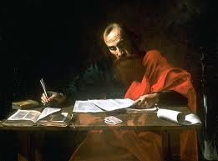
Question #5-
“. . . did not Christ put an end to the Torah”?
^{NKJ} Romans 9:30 Gentiles, who did not pursue righteousness, have attained to righteousness, even the righteousness of faith . . .
20
amiyisrael.org

Slide 21
Question #5-
“. . . did not Christ put an end to the Torah”?
^{NKJ} Romans 10:1-3 Brethren, my heart's desire and prayer to God for Israel is that they may be saved. ² For I bear them witness that they have a zeal for God, but not according to knowledge. ³ For they being ignorant of God's righteousness, and seeking to establish their own righteousness, have not submitted to the righteousness of God.
21
amiyisrael.org

Slide 22
Question #5-
“. . . did not Christ put an end to the Torah”?
^{NKJ} Romans 10:1-3 Brethren, my heart's desire and prayer to God for Israel is that they may be saved. ² For I bear them witness that they have a zeal for God, but not according to knowledge. ³ For they being ignorant of God's righteousness, and seeking to establish their own righteousness, have not submitted to the righteousness of God.
The Jews were trying to use the Torah for the wrong purpose!
22
amiyisrael.org

Slide 23
Question #5-
“. . . did not Christ put an end to the Torah”?
^{NKJ} Romans 10:1-3 Brethren, my heart's desire and prayer to God for Israel is that they may be saved. ² For I bear them witness that they have a zeal for God, but not according to knowledge. ³ For they being ignorant of God's righteousness, and seeking to establish their own righteousness, have not submitted to the righteousness of God.
The Jews were trying to use the Torah for the wrong purpose!
^{NKJ} Galatians 3:24. . . the law was our tutor to bring us to Christ, that we might be justified by faith.
23
amiyisrael.org

Slide 24
Question #5-
“. . . did not Christ put an end to the Torah”?
The purpose of the Torah - bring us to the understanding that we’re doomed without a Messiah.
Like slaves in a foreign land - we need a messiah.
Like people trapped between mountains with an approaching enemy behind and an endless sea before - we need a messiah.
Like a people whose written code does not provide a way for us to “work off” our transgressions but instead requires us to put our hands on the head of an innocent lamb - we need a messiah.
24
amiyisrael.org

Slide 25
Question #5-
“. . . did not Christ put an end to the Torah”?
^{NKJ} Romans 10:4 For Christ is the end of the law for righteousness to everyone who believes.
“telos” (Strong’s 5056)
25
amiyisrael.org

Slide 26
Question #5-
“. . . did not Christ put an end to the Torah”?
^{NKJ} Romans 10:4 For Christ is the end of the law for righteousness to everyone who believes.
“telos” (Strong’s 5056)
“A telos (from the Greek τέλος for "end", "purpose", or "goal") is an end or purpose, in a fairly constrained sense used by philosophers such as Aristotle. It is the root of the term "teleology," roughly the study of purposiveness, or the study of objects with a view to their aims, purposes, or intentions.”
Wikipedia
26
amiyisrael.org

Slide 27
Question #5-
“. . . did not Christ put an end to the Torah”?
^{NKJ} Romans 10:4 For Christ is the end of the law for righteousness to everyone who believes.
“telos” (Strong’s 5056)
“the end term of a goal directed process; especially, the Aristotelian final course.”
Dictionary.com
27
amiyisrael.org

Slide 28
Question #5-
“. . . did not Christ put an end to the Torah”?
“telos” (Strong’s 5056)
^{NKJ} Luke 1:33 "And He will reign over the house of Jacob forever, and of His kingdom there will be no end."
28
amiyisrael.org

Slide 29
Question #5-
“. . . did not Christ put an end to the Torah”?
“telos” (Strong’s 5056)
^{NKJ} Luke 1:33 "And He will reign over the house of Jacob forever, and of His kingdom there will be no end.“
^{NKJ} 1 Corinthians 15:24 Then comes the end, when He delivers the kingdom to God the Father, when He puts an end to all rule and all authority and power.
29
amiyisrael.org

Slide 30
Question #5-
“. . . did not Christ put an end to the Torah”?
“telos” (Strong’s 5056)
^{NKJ} Luke 1:33 "And He will reign over the house of Jacob forever, and of His kingdom there will be no end.“
^{NKJ} 1 Corinthians 15:24 Then comes the end, when He delivers the kingdom to God the Father, when He puts an end to all rule and all authority and power.
^{NKJ} Romans 10:4 For Christ is the purpose of the law for righteousness to everyone who believes.
30
amiyisrael.org

Slide 31
Question #5-
“. . . did not Christ put an end to the Torah”?
We can’t save ourselves . . . we need a Messiah
31
amiyisrael.org

Slide 32
~k,øl' ~Al’v'
Shalom Aleichem
Peace be Unto You

