Slide 1


Rivers of Living Waters
The Message of the Last Great Day
By: Tim Kelley
Notes:
We’re going to study what has come to be known as the “Last Great Day”
Being raised in a Sabbath-keeping family that observed the Biblical Festivals, I am quite familiar with the term.
At festival observances, there were always special messages given on that day
The preacher would oftentimes quote this passage

Slide 2
On the last day, that great day of the feast, Jesus stood and cried out, saying, "If anyone thirsts, let him come to Me and drink. ³⁸ "He who believes in Me, as the Scripture has said, out of his heart will flow rivers of living water.“
^{NKJ} John 7:37-38
2
amiyisrael.org
Notes:
Have you ever considered what John was thinking when he wrote this?
What did he expect his audience to understand about that day? After all …
The “Last Great Day” is no where mentioned in the Tnakh
What made this day different than any of the other day of the festival?
Today, I want to answer those questions, But to do so, I need to lay a little groundwork. I need to:
Help you see the difference between the Hebrew concept of time and that of the Greeks
Explain a little about Jewish Tradition and Yeshua’s attitude toward it.
So Here’s our plan

Slide 3
The Plan:
Show the importance of Cycles in the Scripture
  Timing of the Feast of Tabernacles
Yeshua and Jewish Tradition
The 1st century Water Pouring Ceremony
Notes:
Let’s start with time.

Slide 4
Typical “Greek” Timeline
New Jerusalem
Olam Haba
Yeshua’s Ministry
Messianic
Kingdom
Creation
Exodus
Notes:
This is a representation of a typical Biblical timeline
Linear
Defined beginning
In this case – open ended
Compare that to a “Hebrew” timeline

Slide 5
Hebrew Timeline
Creation
Messianic
Kingdom
Exodus
Yeshua’s
Ministry
Notes:
Hebrews think “circular”
Time never ends –
It just repeats
When you get to the end of one cycle, you simply start the cycle again
Like this

Slide 6
Hebrew Timeline
New Creation
Creation
Messianic
Kingdom
Exodus
Yeshua’s
Ministry
Notes:
The Cycle that started with the Creation ends with A New Creation
Things just repeat themselves
Like Solomon said -

Slide 7
What has been is what will be, and what has been done is what will be done, and there is nothing new under the sun.
^{ESV} Ecclesiastes 1:9
Notes:
To illustrate that point, let’s look at some familiar Biblical Cycles:

Slide 8
1st day
Beginning of the Week
7th day
2nd day
The Week
6th day
3rd day
5th day
4th day
Notes:
The Weekly Cycle:
Starts on the first day –
After the 7th day, you start again with the 1st Day – a NEW WEEK

Slide 9
8th Day
New Beginning
1st day
4th day
5th day
6th day
7th day
2nd day
3rd day
The Week
Notes:
But if you had an event that was 8-days long, that 1st day becomes the 8th day.
Never-the-less, that 8th day is still the beginning of a new cycle.
In the Bible, things that happen on the 8th day are usually significant

Slide 10
  Circumcision (Lev. 12:3)
  Firstborn redeemed (Ex. 22:29)
  Priestly services begin (Lev. 9:1; Num. 6)
  Leper cleansed (Lev. 14:10)
  A child receives his/her name (Luke 1:59)
Notes:
In each of these cases, the eighth days signifies a new beginning
Let’s look at some other Biblical Cycles where the 8th day is significant

Slide 11
Planting Begins Again
1st year
4th year
5th year
6th year
7th year
2nd year
3rd year
The Land Rests
Land Sabbath
Notes:
Land Sabbath begins on the 7th year
The 8th day, Israel begins a new cycle of planting

Slide 12
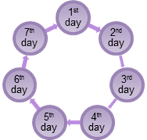
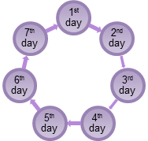
50th / 1st Day of 8th Week
New Beginning
1st day
7th day
2nd day
1st week
7th week
2nd week
Shavuot
(Feast of Weeks)
6th week
3rd week
5th week
4th week
Notes:
Shavuot – Pentecost
You count seven weeks of seven days
On the first day of the 8th week is Shavuot
You might call it the 8th day of the 7th week?
This is the day Israel was betrothed to YHVH
A New Life for the former Egyptian slaves

Slide 13
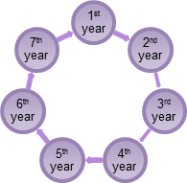
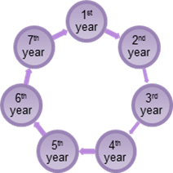
50th / 1st Year of 8th Cycle
New Beginning
Yovell
(Jubilee)
Notes:
Jubilee year
Starts on the year after the 7th cycles of 7 years
Represent freedom for the Hebrew slaves (those owned by ger or toshab)
Land reverts back to it’s former owners
Then we have the festival cycle

Slide 14
Last Day of 7000 year cycle ends here
Shemini Atzoret
(8th day)
Sukkot
(7 Days)
Passover DUB Firstfruits
Festival Cycle
Yom Kippur
Yom Teruah
Shavuot
Notes:
This is a little harder to illustrate,
The festivals do not necessarily represent divisions of time, instead –
They represent events, never-the-less –
Sukkot represents the final 1000 years of a 7000 year cycle
Shimini atzoret (Eighth Day Assembly) begins on the 8th ‘day’ of that cycle of 7 – one thousand year ‘days’

Slide 15
8th Day
New Beginning
Shemini Atzoret
(8th day)
Sukkot
(7 Days)
Passover DUB Firstfruits
Festival Cycle
Yom Kippur
Yom Teruah
Shavuot
Notes:
Shemini Atzoret is not a Last Day, it is a New Beginning
Let’s now look at the Feast of Tabernacle.

Slide 16
Feast of Tabernacles (Sukkot)
Tishri 15
Tishri 16
Tishri 17
Tishri 18
Tishri 19
Tishri 20
Tishri 21
"Speak to the children of Israel, saying: 'The fifteenth day of this seventh month shall be the Feast of Tabernacles for seven days to the LORD.
^{NKJ} Leviticus 23:34
16
amiyisrael.org
Notes:
Sukkot is a 7-day festival
It spans 1000 years of a cycle of seven one-thousand year periods.
Starts on Tishri 21 and goes for 7 days
The last day of the feast of tabernacles is the 7th day, Tishri 21

Slide 17
Feast of Tabernacles (Sukkot)
Tishri 15
Tishri 16
Tishri 17
Tishri 18
Tishri 19
Tishri 20
Tishri 21
'You shall dwell in booths for seven days. All who are native Israelites shall dwell in booths …’
^{NKJ} Leviticus 23:42
17
amiyisrael.org
Notes:
You are to dwell in booths for 7 days, which implies
You don’t have to stay in a booth on the 8th day. – WHY
It is a new festival – New Beginning (Lev. 23:36)

Slide 18
Feast of Tabernacles (Sukkot)
Tishri 15
Tishri 16
Tishri 17
Tishri 18
Tishri 19
Tishri 20
Tishri 21
Tishri 22
Shemini Atzaret
A New Beginning
18
amiyisrael.org
Notes:
As we have seen –
In Hebrew cycles that are based on 7 days, weeks, or years -
The ‘day’ after the seventh day is a New Beginning.
The 8th Day is not the topic of this message
But it is important to understand the cycle in order to understand what happened on The Last Great Day
Let’s talk a little about Jewish tradition –
Was Yeshua was opposed to all Jewish tradition
The truth is that He did indeed participate in a number of Jewish traditions, as long as they did conflict with the Torah – (Mark 7:8-9)
Examples

Slide 19
Some Jewish Traditions observed or used by Yeshua:
the traditional readings in the synagogue (Luke 4:16-20; Acts 13:14-15; 15:21)
the traditional rabbi-disciple system
baptisms
Hanukkah (John 10:22)
Notes:
Tradition is not bad as long as it does not violate God’s law
Every church has its traditions
Service Format
Dress Code
We are observing this festival on a time frame based on Jewish Tradition,
Let’s now take a look at a Jewish tradition that was observed by Yeshua and His disciples during the Feast of Tabernacles -
That tradition is called the Water Drawing Ceremony

Slide 20
Beit haShoeva
House of the Water Drawing
20
amiyisrael.org
Notes:
In the first century, it was a tradition during the Feast –
draw “living water” from the Pool of Shiloam each morning
The ceremony was called “Beit haShoeva” - the House of the Water Drawing
Where did it come from? Jewish Tradition! It was a Jewish creation -
The Jewish sages observed that God would oftentimes liken His Holy Spirit and Salvation to water being poured out.
They had for some time understood scriptures such as Isaiah 55:1 -

Slide 21
^{NKJ} Isaiah 55:1 "Ho! Everyone who thirsts, Come to the waters …
21
amiyisrael.org
Notes:
and Isaiah 43:19 (read from slide)

Slide 22
Isaiah 43:19-20 Behold, I will do a new thing, Now it shall spring forth; Shall you not know it? I will even make a road in the wilderness And rivers in the desert. ²⁰ The beast of the field will honor Me, The jackals and the ostriches, Because I give waters in the wilderness And rivers in the desert, To give drink to My people, My chosen.
22
amiyisrael.org
Notes:
to pertain to an end-time return of the Hebrew people to the Land
They saw a salvation aspect as well based on scriptures like Isaiah 12:2-3 -

Slide 23
Isaiah 12:2-3 Behold, God is my salvation, I will trust and not be afraid; 'For YAH, the LORD, is my strength and song; He also has become my salvation.' " ³ Therefore with joy you will draw water From the wells of salvation.
23
amiyisrael.org
Notes:
These all pertain to the coming of the Messiah and the restoration of the Messianic kingdom
t would be a Great Salvation that will occur during that time
The sages also understood that the prophet Joel had indicated there would be a great outpouring of God’s spirit sometime after Yeshua’s kingdom was firmly established -

Slide 24
Joel 2:28 " And it shall come to pass afterward that I will pour out My Spirit on all flesh;
24
amiyisrael.org
Notes:
Because they saw these connections –
They were able to connect water to the Holy Spirit, and the great outpouring of the Holy Spirit to the latter part of the Messianic Kingdom.
The Jewish sages were also well versed in the Scriptures.
They believed that every word of the Torah was God-breathed down to the individual letters
If they saw something peculiar in the way a word was spelled or in how a sentence was structured
they might develop a teaching or tradition around it,
thinking that God intentionally put it there to teach them something.
One such peculiarity happens in Numbers 29, the portion of scripture that deals with offerings during the Feast of Tabernacles
They found extra letters in some words, and when put those letters together, they spelled “mayim” – water
CONTINUE COMMENTARY

Slide 25
Joel 2:28 " And it shall come to pass afterward that I will pour out My Spirit on all flesh;
25
amiyisrael.org
Notes:
So they developed a tradition
where every morning during the feast the priests would:
draw “living water” from the Pool of Shiloam each morning
the pool that sustained the Jewish people during Hezekiah’s day
Other priests would bring long willow branches through the eastern gate of the Temple mount, waving them back and forth
To simulate the Holy Spirit which they felt would be prevalent during the Messianic Kingdom.
The Hebrew word for wind is the same as for spirit – “ruach”

Slide 26
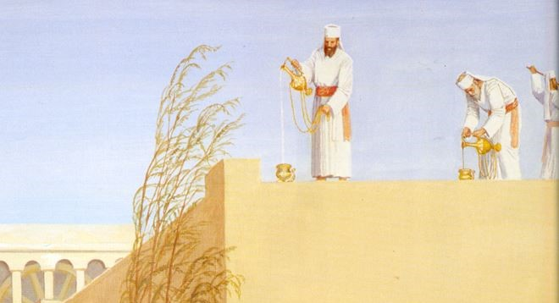
26
amiyisrael.org
Notes:
Still other priests would lay sacrifices on the altar,
those with water and willows would reach the Temple gates,
Priests with the water and wine would ascend the altar. At the same time –
Priests with willows would circle the alter 1 time waving their willow branches,
Making the sound of the “ruach” - ‘wind’ and ‘spirit’
Patterned somewhat like the circuits the Hebrews took around the city of Jericho 1500 years earlier

Slide 27
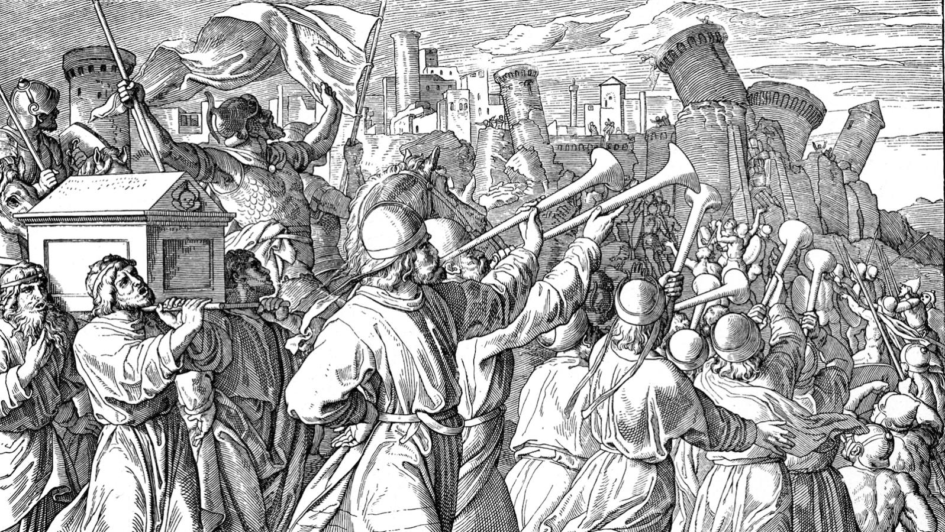
27
amiyisrael.org
Notes:
For 6 days the Hebrews would march one time around the city carrying shofars, but not blowing
On the 7th day – march 7 times - blow shofars – make a great shout
They expected the wall to fall down
On the 7th day – the Last Day of Sukkot, the Jews did the same

Slide 28
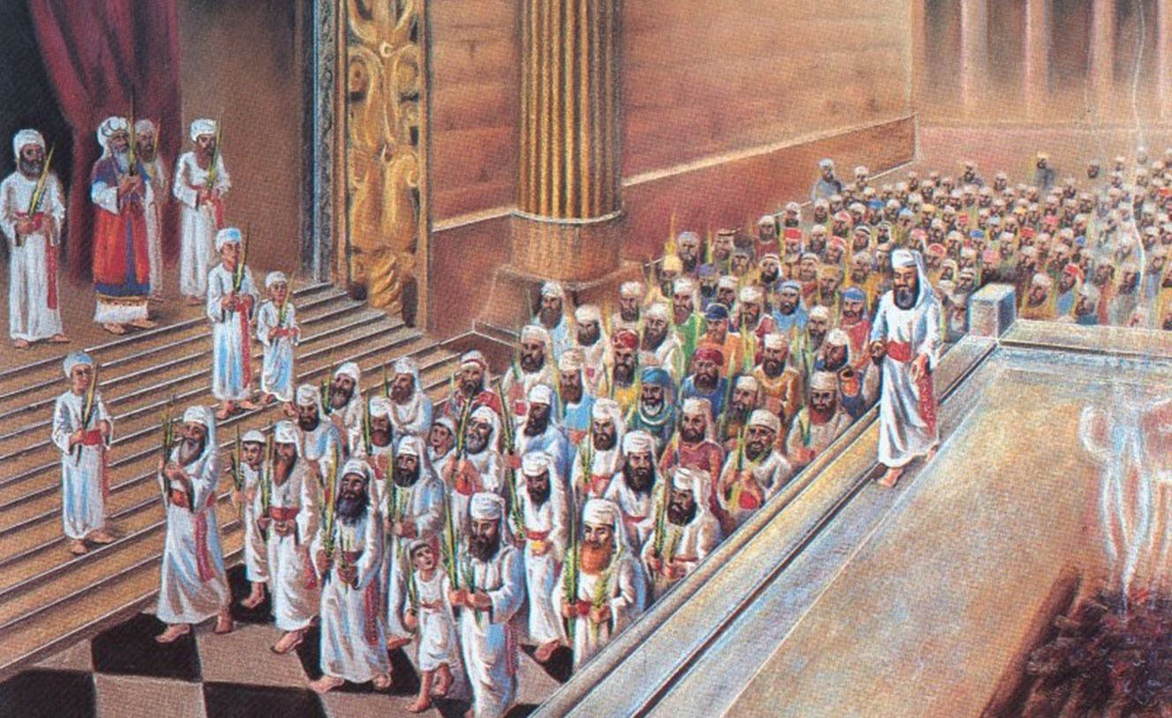
28
amiyisrael.org
Notes:
On the 7th day they would -
circle the altar seven times
blow the silver trumpets
shout for joy as the water and wine were poured on the altar.
Fourteen hundred years earlier at Jericho,
that shout resulted in the walls of Jericho falling down thus “opening the gate” you might say, to the Promised Land.
For the Jews in the first century, it signified a great outpouring of the Holy Spirit and the salvation that would come to the Hebrew people.
This seventh – or Last Day of the Festival – was called “Hoshanna Rabba”

Slide 29
Feast of Tabernacles
Tishri 21
Tishri 15
Tishri 16
Tishri 17
Tishri 18
Tishri 19
Tishri 20
Tishri 22
Hoshanna Rabbah
the Great Salvation
29
amiyisrael.org
Notes:
Based on the Psalm 118:24

Slide 30
^{ESV} Psalm 118:25-29 Save us, we pray, O LORD! O LORD, we pray, give us success! ²⁶ Blessed is he who comes in the name of the LORD! We bless you from the house of the LORD. ²⁷ The LORD is God, and he has made his light to shine upon us. Bind the festal sacrifice with cords, up to the horns of the altar! ²⁸ You are my God, and I will give thanks to you; you are my God; I will extol you. ²⁹ Oh give thanks to the LORD, for he is good; for his steadfast love endures forever!
“hosheana-ana”
save us now, we pray we pray
30
amiyisrael.org
Notes:
Part of the Hallel psalms of praise were written by King David
Though parts of the Hallel psalms were read throughout the festival, on this day, they were apparently all read
Thus “the GREAT DAY” of praise!
The phrase (read highlighted on next slide)

Slide 31
Save us, we pray, O LORD! O LORD, we pray, give us success! ²⁶ Blessed is he who comes in the name of the LORD! We bless you from the house of the LORD. ²⁷ The LORD is God, and he has made his light to shine upon us. Bind the festal sacrifice with cords, up to the horns of the altar! ²⁸ You are my God, and I will give thanks to you; you are my God; I will extol you. ²⁹ Oh give thanks to the LORD, for he is good; for his steadfast love endures forever!
^{ESV} Psalm 118:25-29
31
amiyisrael.org
Notes:
… was traditionally chanted when a King came into town –
Also a part of the ancient Jewish wedding custom
It as also chanted all along the way as Yeshua rode a colt from the Mount of Olives through the gates of Jerusalem as He attended that year’s Sukkot

Slide 32
Now when they drew near Jerusalem, to Bethphage and Bethany, at the Mount of Olives, He sent two of His disciples … ⁷ Then they brought the colt to Jesus and threw their clothes on it, and He sat on it. ⁸ And many spread their clothes on the road, and others cut down leafy branches from the trees and spread them on the road. ⁹ Then those who went before and those who followed cried out, saying: "Hosanna! 'Blessed is He who comes in the name of the LORD!' ¹⁰ Blessed is the kingdom of our father David that comes in the name of the Lord! Hosanna in the highest!“
^{NKJ} Mark 11:1-10
32
amiyisrael.org
Notes:
That’s about a mile walk, and because of the terrain, takes about 30 minutes
An open expression that Yeshua was making – the King is coming.
Many of the people who attended Sukkot that year believed Yeshua was indeed the King –
They hoped that He would somehow take the Kingdom by force, but
That wasn’t part of the plan.
Instead, He took part in the various festival activities like the rest of His Jewish brothers.
One of which was the daily water drawing ceremony
So let’s set the stage for what we read John 7

Slide 33
33
amiyisrael.org
Notes:
The Setting - Hoshanna Rabba – the last and Great Day of the feast of Tabernacles
7th day of the feast of Tabernacles – the Eighth Day being a separate festival.
It’s about 9 AM – the time for the daily sacrifices
pilgrims gathered - – somewhat dried out lulavs in their hands, awaiting the Beit HaShoava
swish-swish sound of the willow-bearing priests is getting louder and louder
swinging their large willow branches back and forth in front of them
another group of priests are making their way back from the Pool of Siloam
CONTINUE COMMENTARY

Slide 34
34
amiyisrael.org
Notes:
As the two groups converge,
priests continue to lay the sacrifices on the altar
High Priest and his assistant ascend the altar with the water and the wine
those with willows begin to walk around the altar in an orderly procession
swish-swish is now quite loud, and as the High Priest pours his pitcher of water onto the altar
the people begin to shout – just as they did at Jericho.
As the priests began to stand their willow branches alongside the altar, shouting begins to subside
a familiar, but obviously amplified voice broke through the calm saying –

Slide 35
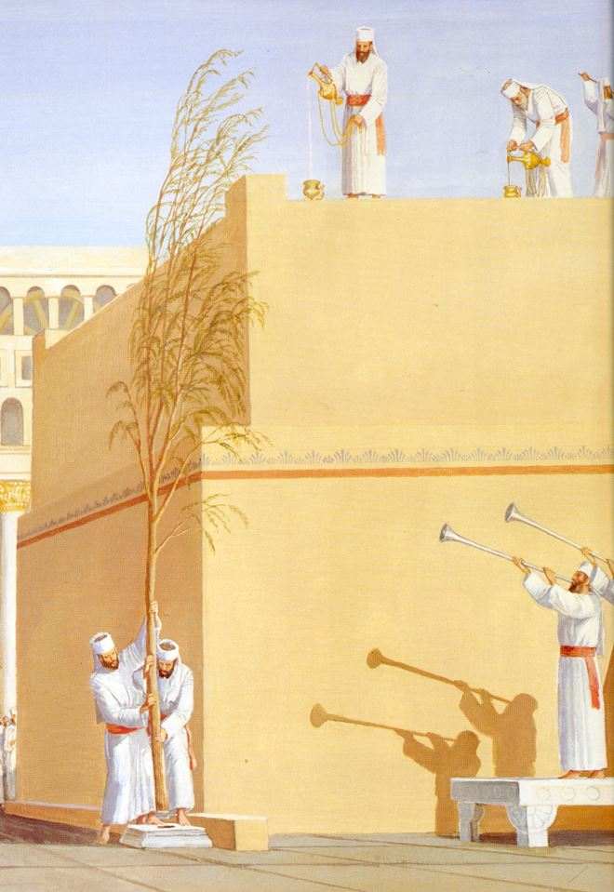
… "If anyone thirsts, let him come to Me and drink. He who believes in Me, as the Scripture has said, out of his heart will flow rivers of living water.“
^{NKJ} John 7:37-38
35
amiyisrael.org
Notes:
the voice of Messiah Yeshua – one of the thousands of Jews who came yearly to observe the Feast of Tabernacles.
Though they did not understand what He was doing, and why He did it, the disciples soon came to understand that –
^{NKJ} John 7:39 … He spoke concerning the Spirit, whom those believing in Him would receive …
What was Yeshua doing?
On this Last Day, the Great Day of the feast -
He was confirming that the Jews were correct – the Holy Spirit would be poured out during the latter part of the Messianic Kingdom –
He waw confirming that Salvation would come to Israel
Without publicly stating it, He was confirming to those who believed on Him - the ones who had laid willow branches and their garments on the road as He made his way from the
Mount of Olives to Jerusalem, that He was indeed the King – the Anointed one – Israel’s Messiah.

Slide 36
~k,øl' ~Al’v'
Shalom Alechim
Peace be Unto You

Slide 37
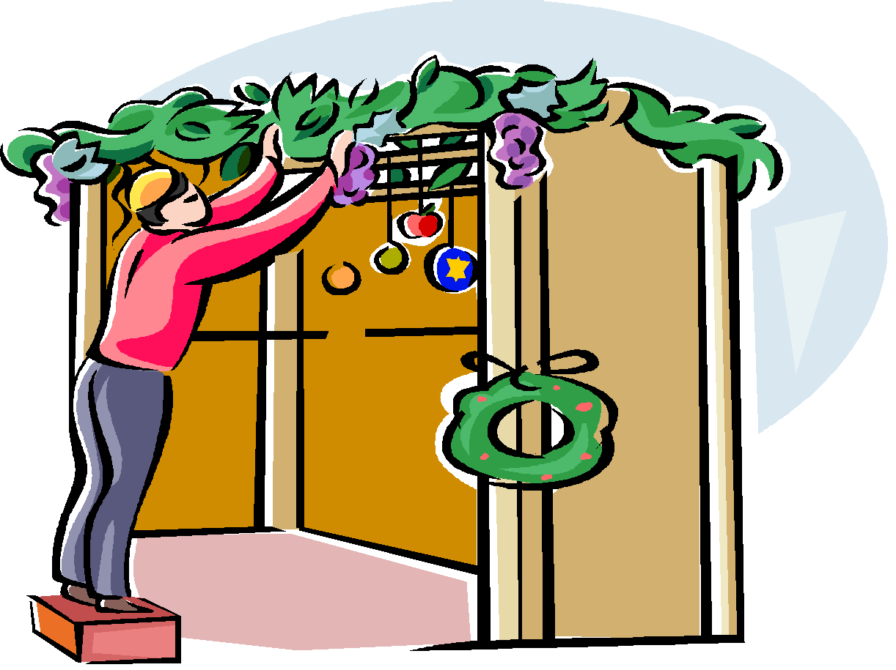

Slide 38
